Slide 1
Monograph on Land Reform in 13 Countries – Result of International Cooperation
BALTIC SURVEYING’21
Alexandr Vlasov
Samara regional division of Russian Academy of Science (Russia)

Slide 2
Participating countries
Moldova
Poland
Romania
Russian Federation
Slovakia
Ukraine
Azerbaijan
Belarus
Estonia
Georgia
Kazakhstan
Latvia
Lithuania

Slide 3
The collective monograph «Land Reform: From State Monopoly to Diversity of Ownership» is the result of cooperation between scientists from different countries, whose research interests include wide range of problems of land use, land management, land administration, history of land relations, etc.

Slide 4
Authors:
INTRODUCTION – Daugaliene Vilma, LANDNET, FAO
AZERBAIJAN – Mirzayev Natig, Balayev Rasul, Veliyev Akif
BELARUS – Kolmykov Andrei, Myslyva Tamara, Pisetskaya Olga
ESTONIA - Maasikamae Siim
GEORGIA – Meskhishvili Anzor, Sichinava Alexander, Sekhniashvili Dali
KAZAKHSTAN – Ozeranskaya Nataliya, Makenova Saule, Toleubekova Zhanat
LATVIA – Parsova Velta, Jankava Anda
LITHUANIA – Aleknavicius Audrius, Aleknavicius Marius, Valciukiene Jolanta

Slide 5
MOLDOVA – Horjan Oleg, Buzu Olga, Sirbu Rodica
POLAND – Kurowska Krystyna, Kowalczyk Cezary, Kryszk Hubert
ROMANIA – Marian Madalina-Cristina
RUSSIAN FEDERATION – Khlystun Victor , Vlasov Alexander , Vasilieva Darya , Khasaev Gabibulla
SLOVAKIA – Hudecova Lubica
UKRAINE - Stoiko Nataliia , Kryshenyk Nadiia

Slide 6
The monograph presents characteristics of the essence, content and results of land reforms in different countries of Central and Eastern Europe, Western and Central Asia, which made the transition from centrally planned to market economy at the end of the last century. While there are common goals of land reforms, each of the countries has chosen its own path of reform, taking into account historical features of land relations development, which differ in political and methodological approaches, methods, tools and achieved results.

Slide 7
Acknowledgements:
The team of authors expresses their gratitude and appreciation to:
for the idea to write this monograph, for interested participation in the creation process, for provision of funds for the editing and publication of the monograph – to Dr. Gabibulla Khasaev, Professor of Samara National Research University named after Academician S.P. Korolev, Honored Economist of the Russian Federation

Slide 8
for management, supervision and coordination of authors’ working process, implementation of editing and publication process – to:
Dr. Alexandr Vlasov, Honoured Land Surveyor of Russian Federation
Velta Parsova, Dr. of Economics, Professor of Latvia University of Life Sciences and technologies
- Darya Vasilieva, Candidate of Biological Sciences, Associate Professor at Samara State Technical University

Slide 9
for scientific editing – to Viktor Khlystun, Academician of the Russian Academy of Sciences, Doctor of Economics, Professor of the State University of Land Management (Moscow)
for providing materials and scientific advices – to Nicolai Komov, Academician of the Russian Academy of Sciences, Doctor of Economics, Professor, Honoured Land Surveyor of the Russian Federation

Slide 10
for reviewing the monograph - to:
Irina Pilvere, Dr.oec., professor, Rector of Latvia University of Life Siences and Technologies, member of the Latvian Academy of Sciences
Mamai Oksana, Doctor of economic sciences, professor of Samara State Agricultural Academy (Russia)

Slide 11
November 2017 Professors Velta Parsova and Armands Celms from Latvia University of Life Sciences and Technologies visited Department of Land Management and Cadastre of Samara State University of Economics
The history of creation of monograph

Slide 12
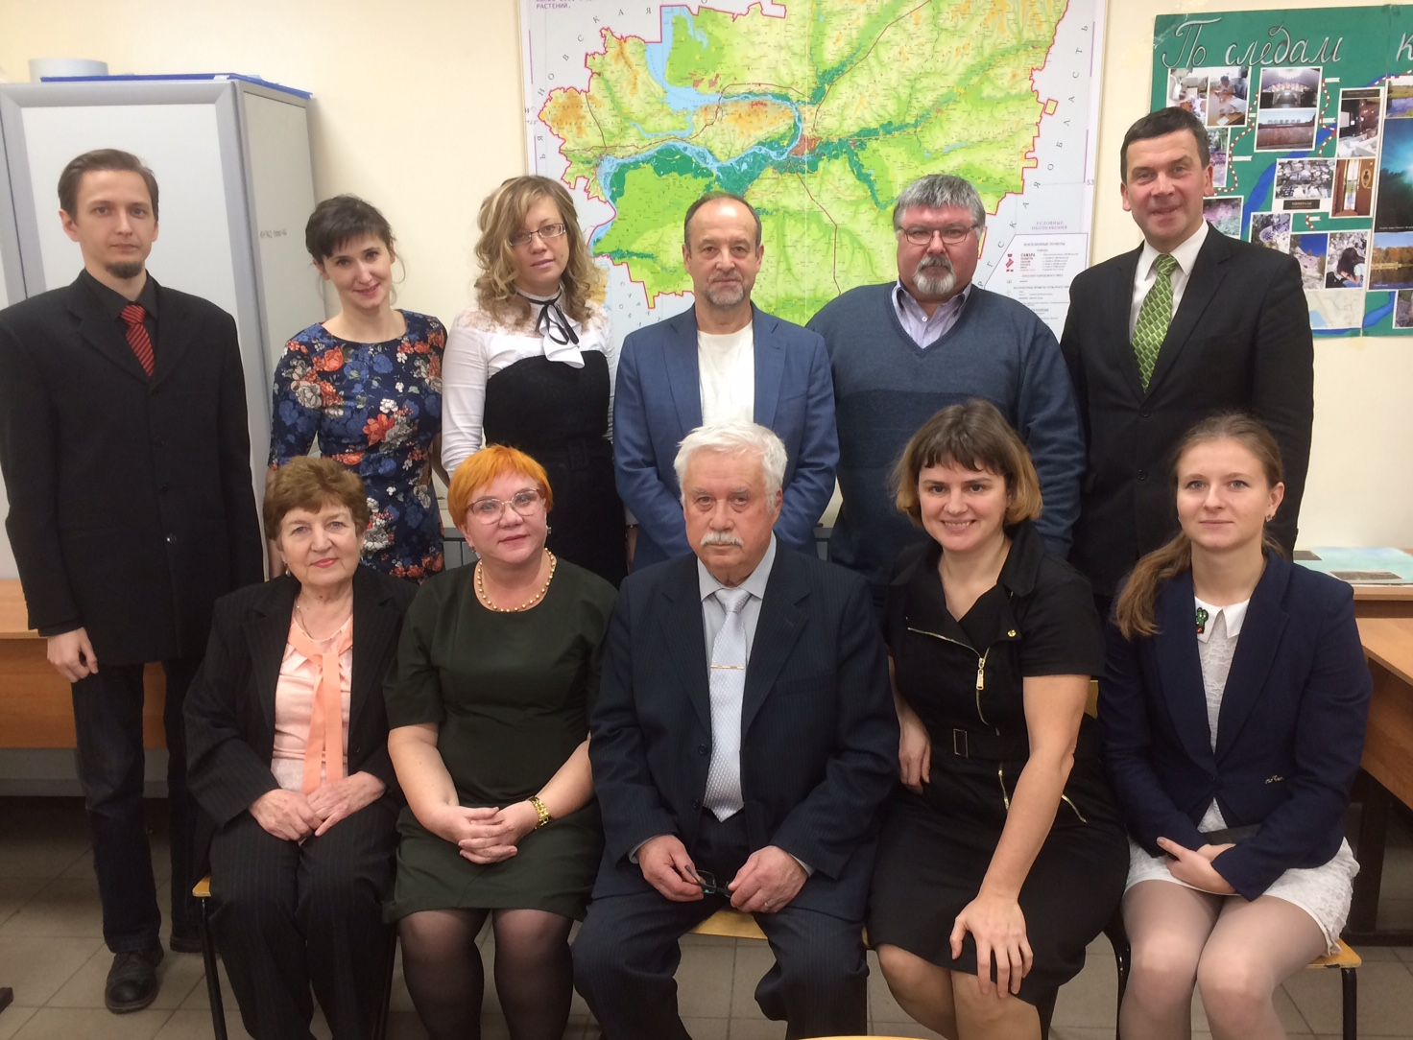

Slide 15
Baltic Surveying’18 University of Warmia and Mazury in Olsztyn, Poland

Slide 16
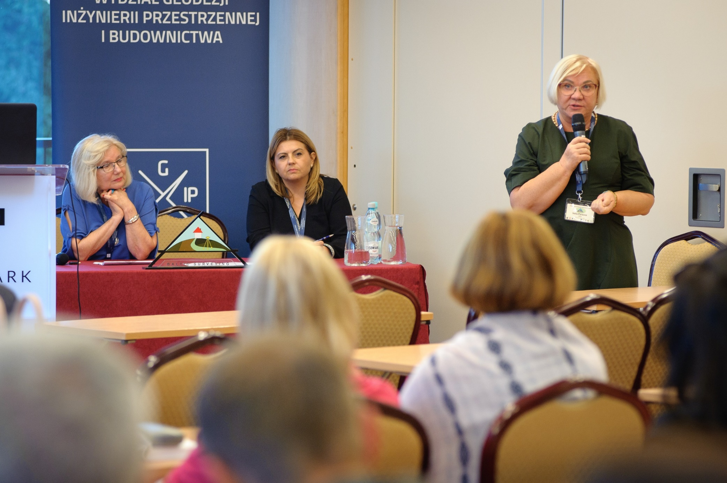

Slide 17
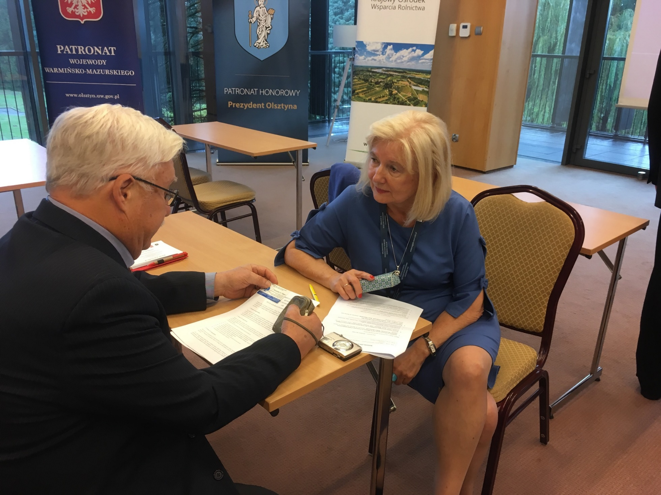

Slide 18
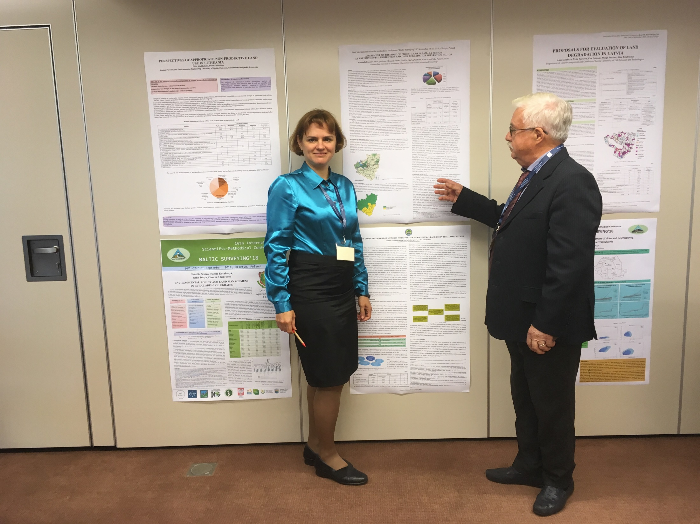

Slide 19
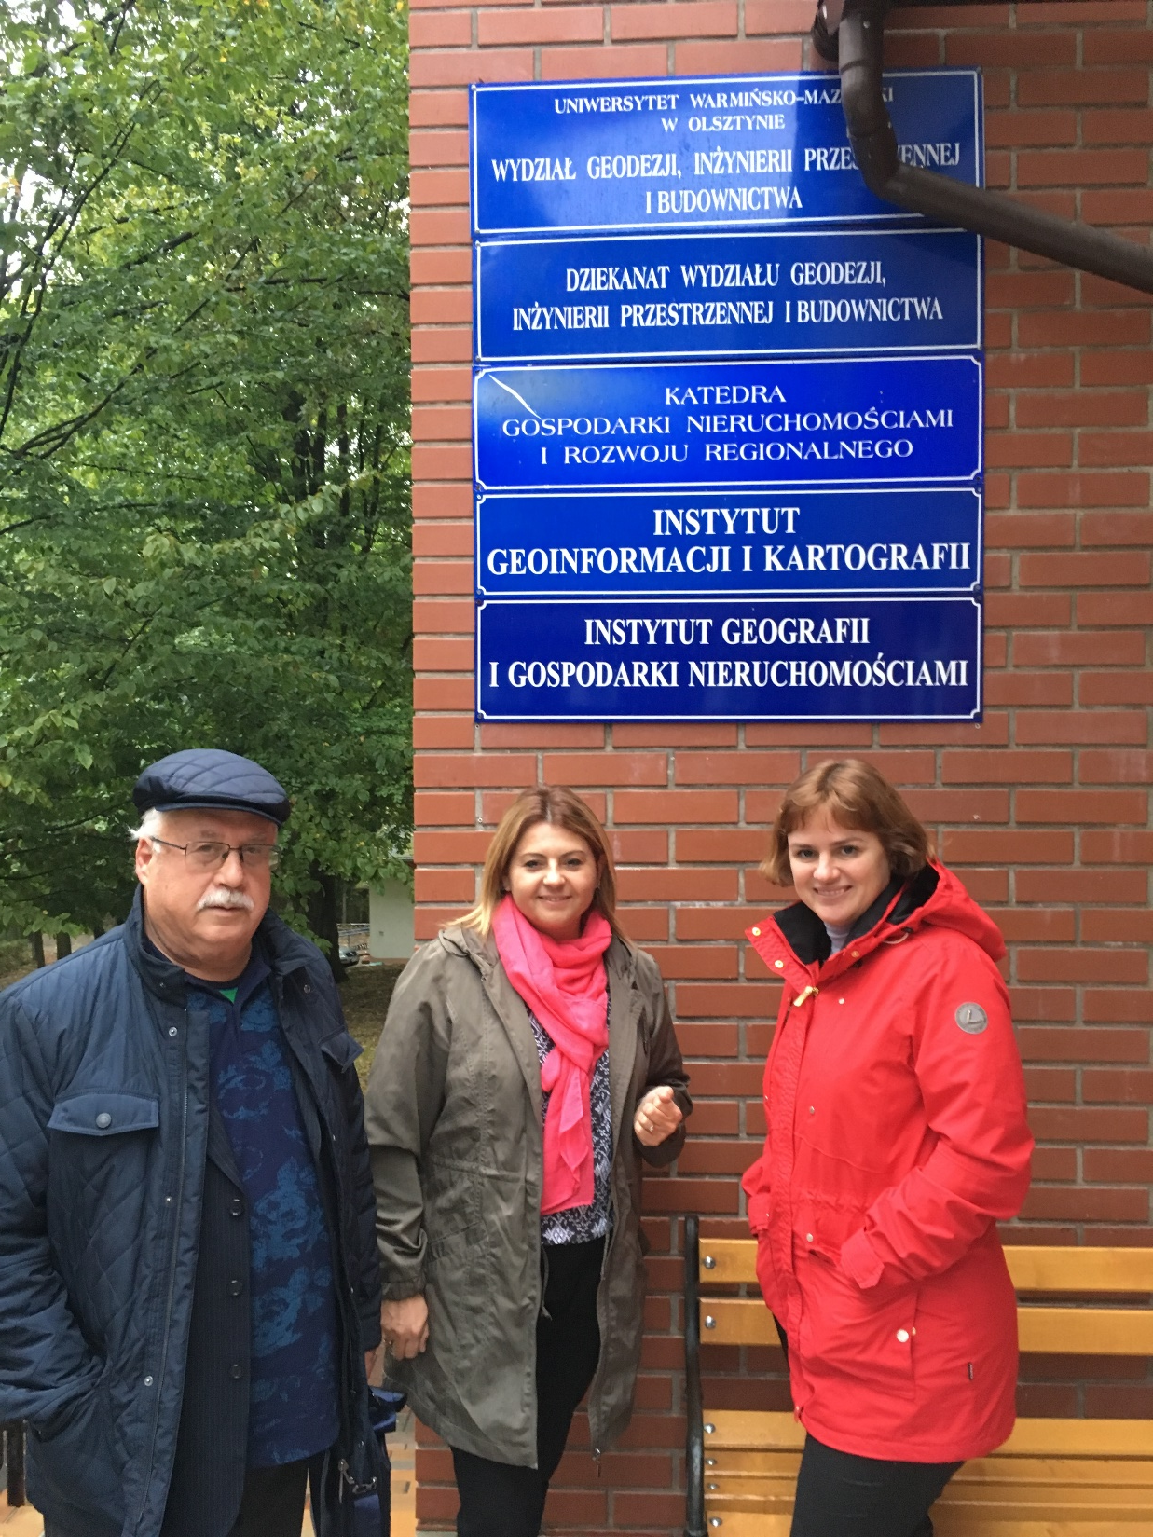

Slide 20
October 2018, Chisinau, Moldova International scientific-practical symposium "Sustainable development of rural areas - achievements and prospects", dedicated to the 85th anniversary of the State Agrarian University of Moldova

Slide 21
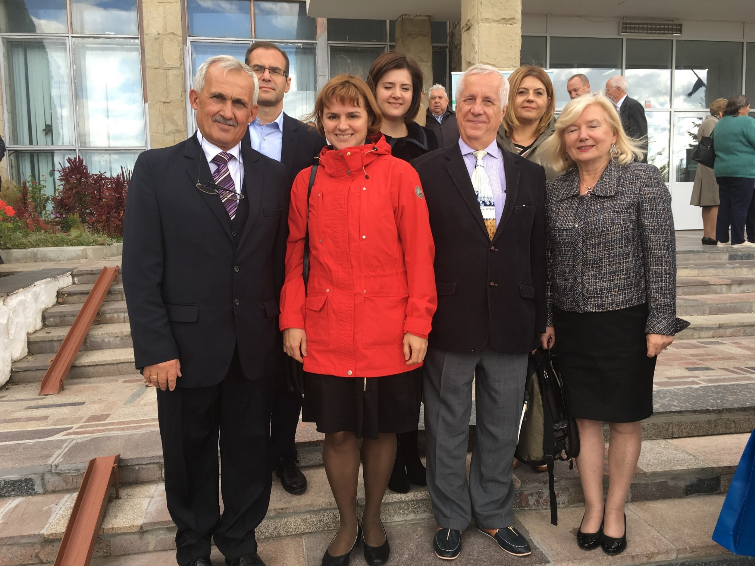

Slide 23
May 2019, Kaunas Lithuania Discussion of the draft of monograph by the authors at the BALTIC SURVEYING'20 conference at Vytautas Magnus University

Slide 26
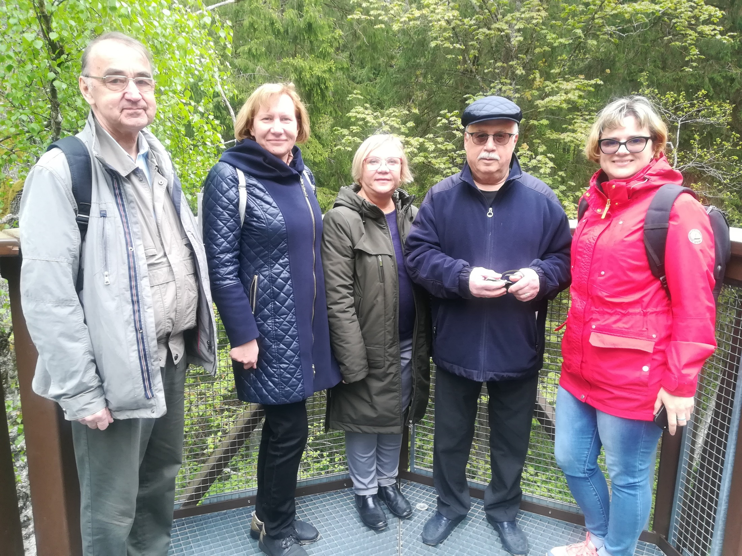

Slide 27
September 2019 Professors Velta Parsova and Armands Celms from Latvia University of Life Sciences and Technologies, Sabina and Ryshard Žrobek, Kristina Kurowska and Cesary Kowalczuk from University of Warmia and Mazury in Olsztyn (Poland) and Audrius Aleknavicius from Vytautas Magnus University (Lithuania) visited Samara State University of Economics

Slide 28
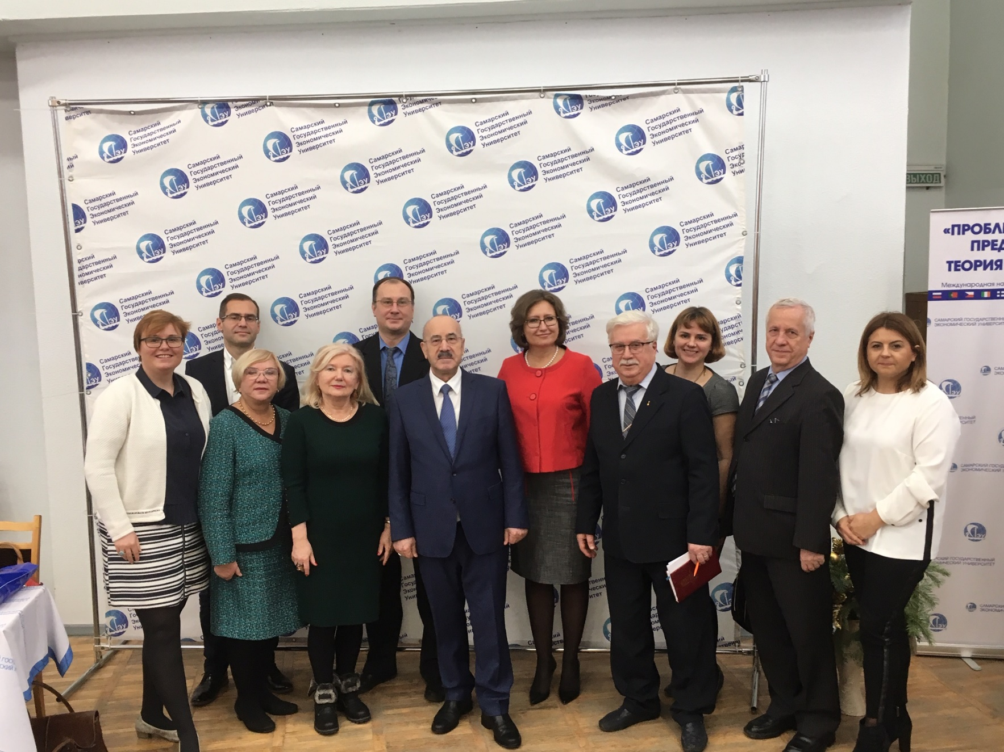

Slide 29
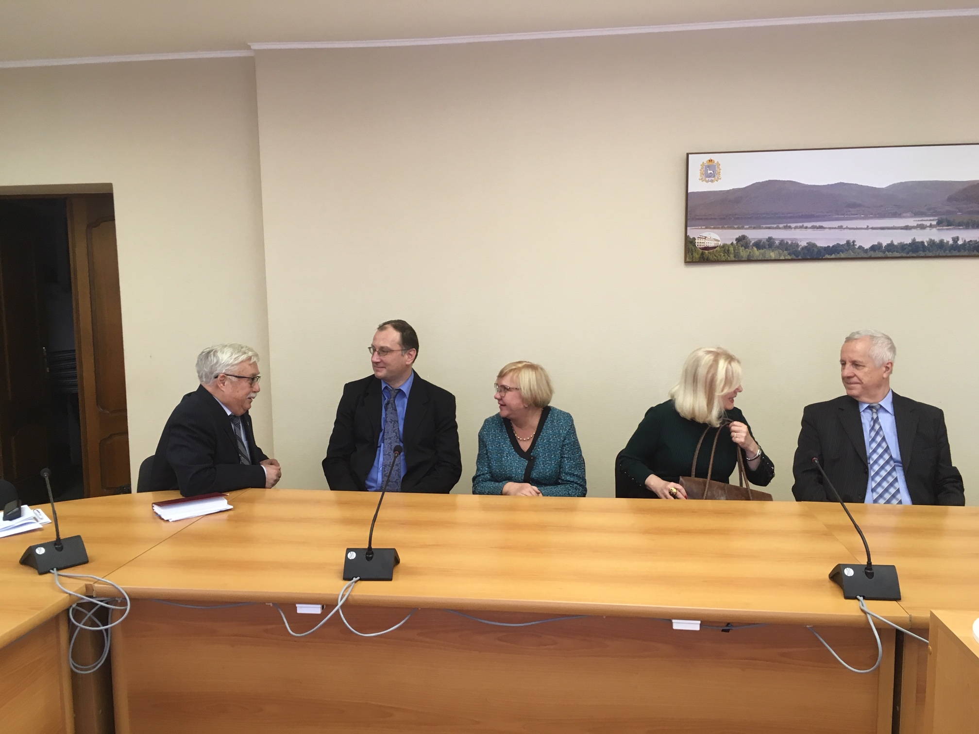

Slide 30
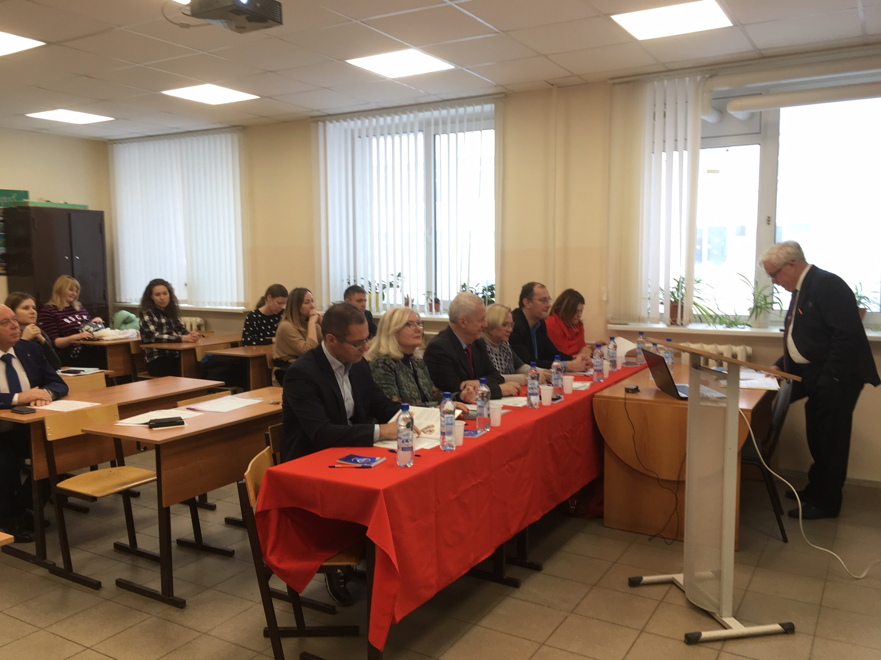

Slide 31
September 2019, Gorki, Belarus International scientific-practical conference, dedicated to the 95th anniversary of the Faculty of Land Surveying of the Belarusian State Agricultural Academy "Land Surveying, Geodesy and Cadastre: Past-Present-Future".

Slide 32
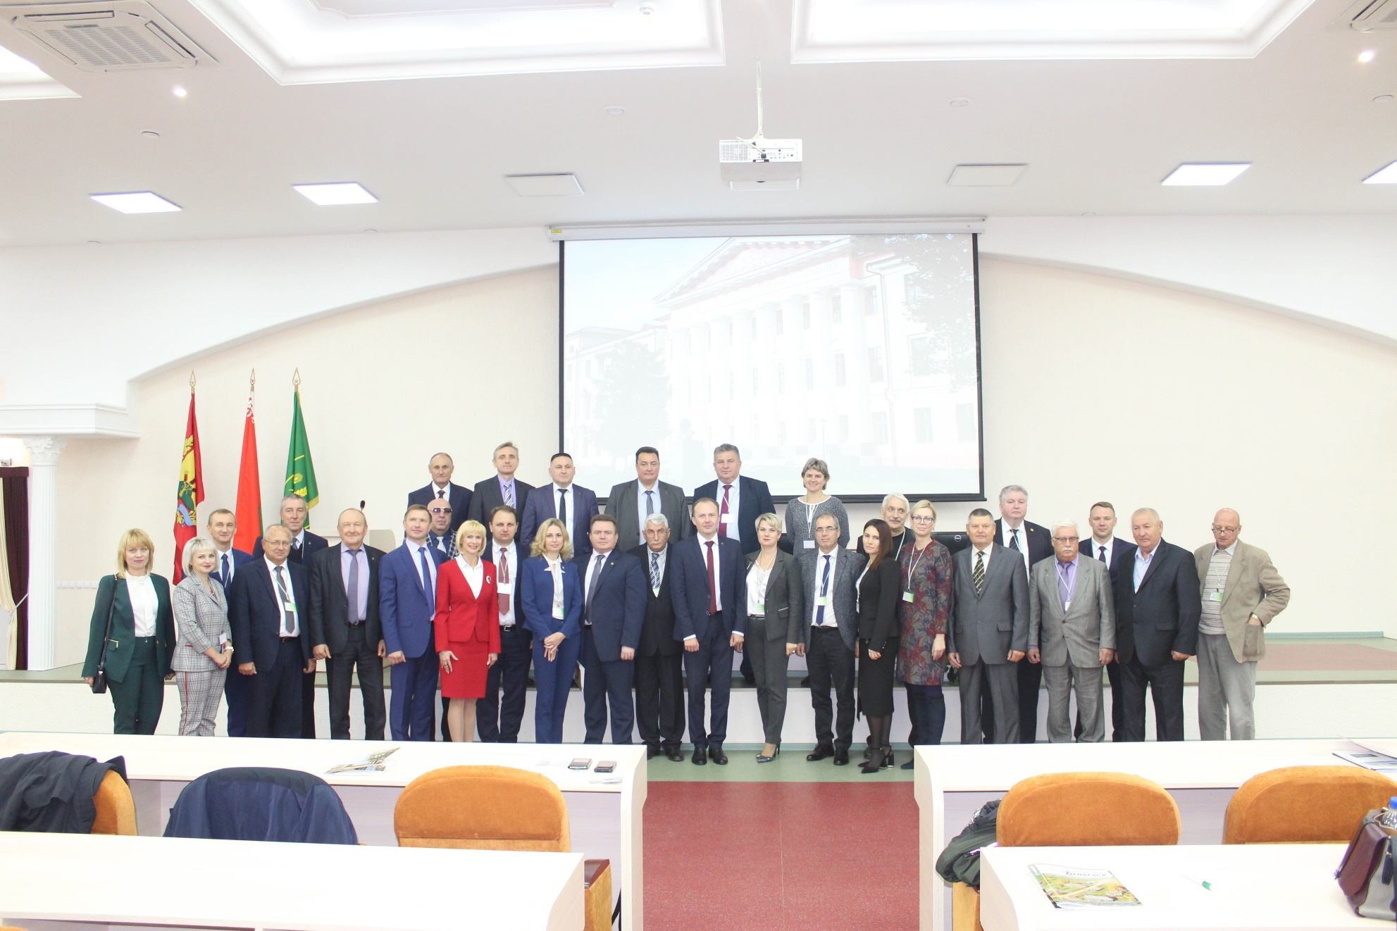

Slide 33
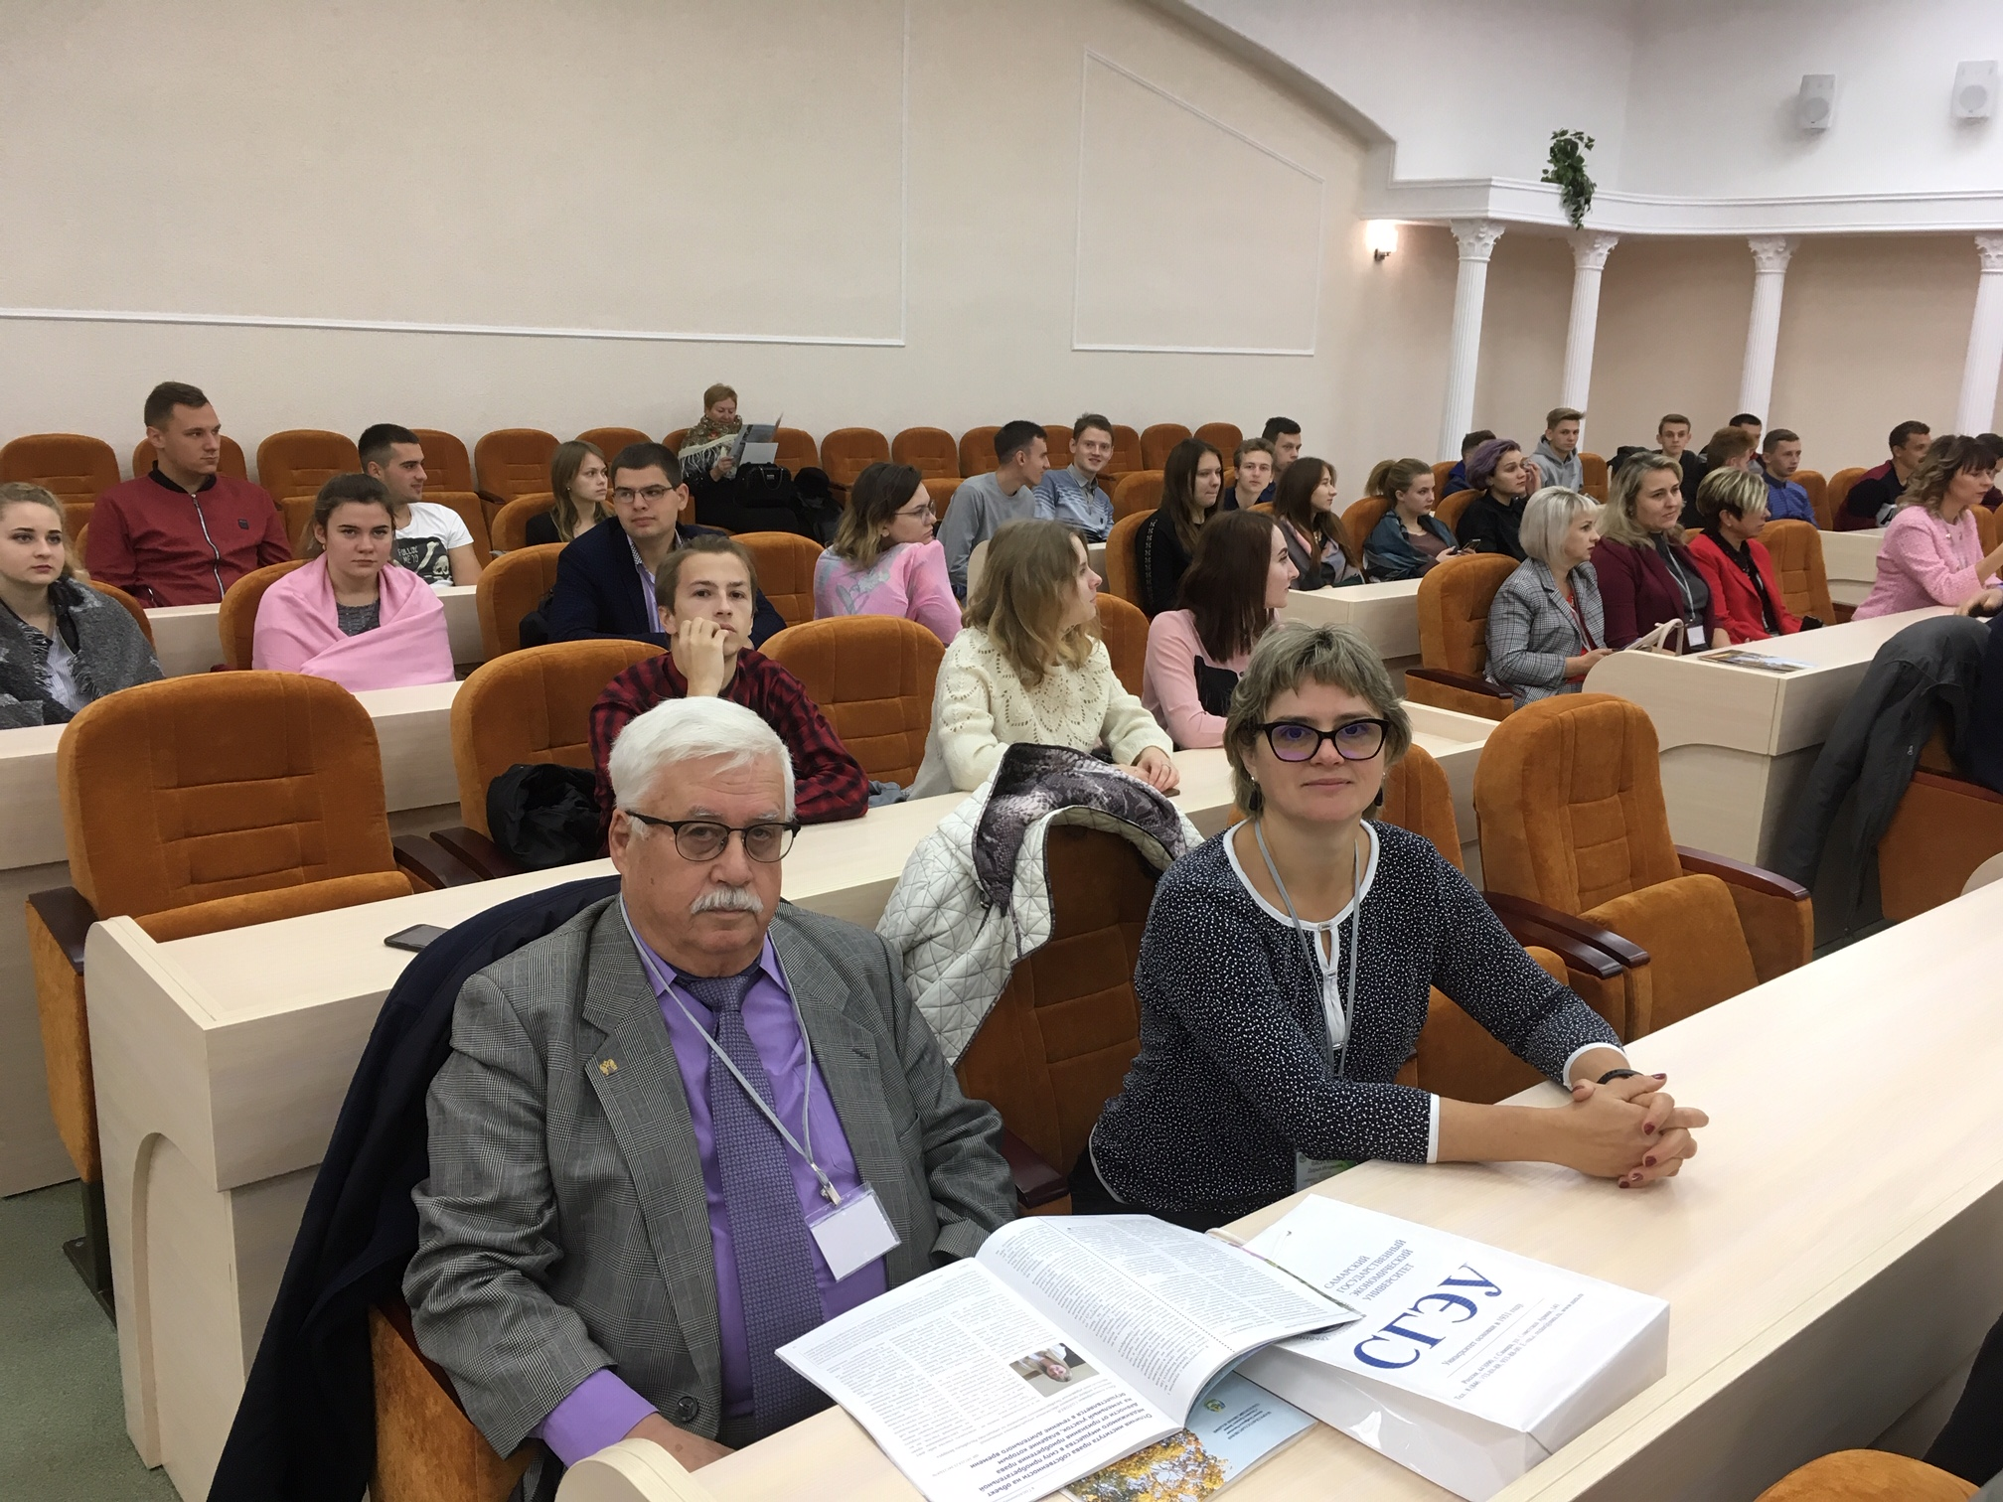

Slide 34
September 2020 The Russian version of monograph is published

Slide 35
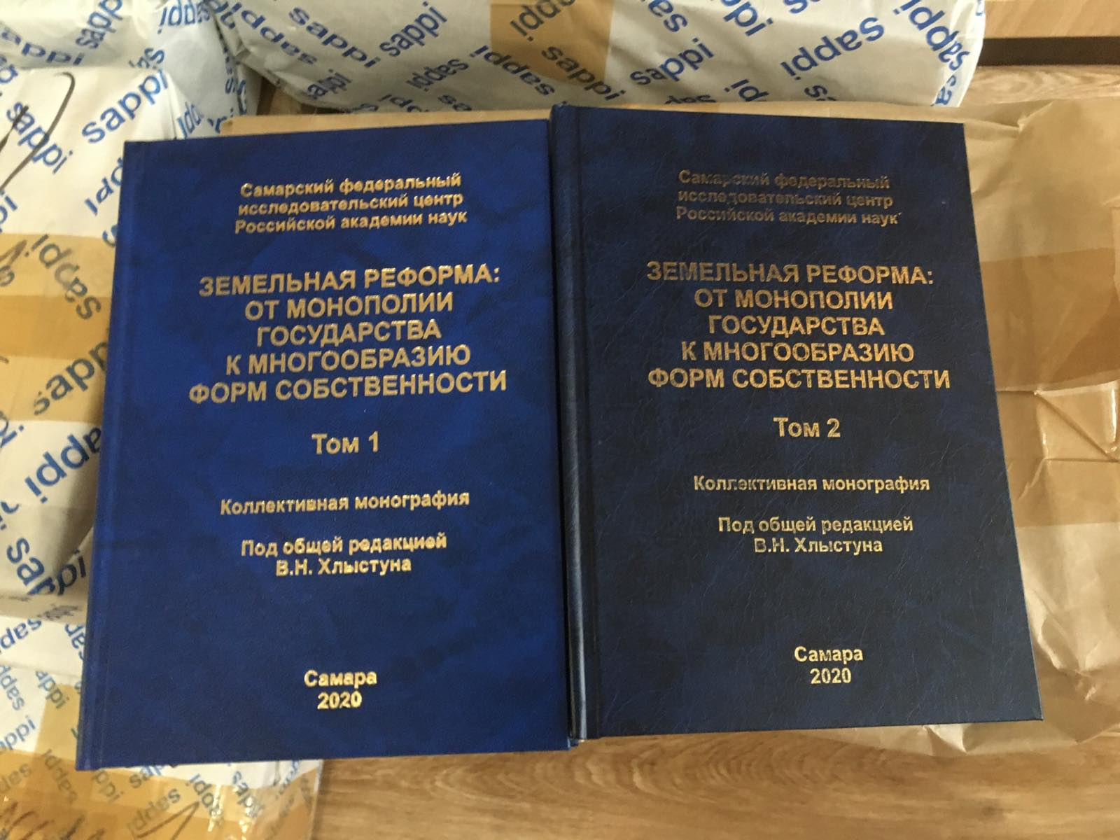

Slide 36
Thank you for your attention!

