Slide 1
Belarusian State Agricultural Academy
Faculty of Land Management
CURRENT STATE AND PROSPECTS
FOR USE OF LAND RESOURCES IN THE REPUBLIC OF BELARUS
Andrey V. Kolmykov
Doctor of Economic Sciences, Professor,
First prorector of Belarusian State Agricultural Academy
Alexey N. Avdeev
Assistant of the Department of Land Management,
Belarusian State Agricultural Academy

Slide 2
state land resources administration
Land management is an instrument of:
redistribution among sectors of the national economy
land relations reforming
introduction of new forms of land management
formation of new land users
the organization of effective use and protection of land
intra-farm organization of the territory of agricultural organizations

Slide 3
Land management in Belarus is regulated:
Constitution of the Republic of Belarus
The Land Code of the Republic of Belarus (1999 and 2008),
Presidential Decree № 667 of December 27, 2007 "On seizure and allocation of land plots“
other normative and legal acts.

Slide 4
General coordination of land use activities in the Republic of Belarus is effected by the State Committee on Property of the Republic of Belarus
Direct land use-planning is handled by:
land surveying organizations
head departments of land development of administrative areas
land resources management agencies of administrative districts
Notes:
.

Slide 5
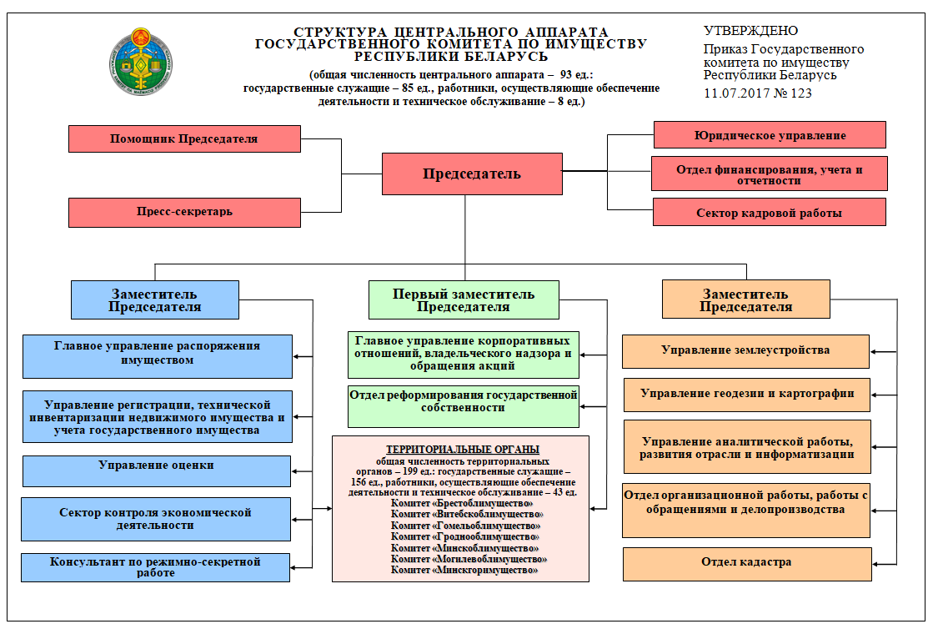
Structure of the State Committee on Property of the Republic of Belarus

Slide 6
The number of employees engaged in land-use system, enterprises under the command of the State Committee on Property of the Republic of Belarus accounts for 1542 people, and that of local land-use offices comes to 1344.

Slide 7
According to the Land Code of the Republic of Belarus, land management is a set of measures for land inventory, land use planning, establishment (restoration) and fixing of boundaries of land management facilities and other land management measures aimed at increasing the efficiency of land use and its protection.

Slide 8
Directions of land management in Belarus
formation of new land uses and consolidation of their boundaries on the terrain and legal registration
creation of the information database on land (IDL)
optimization of land use
cadastral valuation of lands
development of the Geoportal of the land information system of the Republic of Belarus

Slide 9
Land management provided in the republic can be divided into interfarm and intrafarm one. Objects of land-use planning and control include all lands of the Republic of Belarus, land boundaries as well as plots of land irrespective of the form of their ownership.

Slide 10
geography-specific land-use and land conservation patterns
land management schemes of administrative-territorial and geographical units
Planning
documentation
projects of organization of land areas of different territorial entities
interfarm and intrafarm land regulation schemes
projects connected with land protection and land reclamation

Slide 11
Composition and structure of the land fund of the republic in the context of land categories as of 01.01.2020

Slide 12
Composition and structure of the land fund of the republic in the context of land types as of 01.01.2020

Slide 13
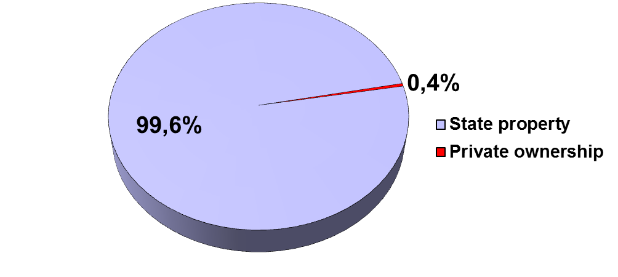
The state owns 20683.6 thousand hectares or 99.6% of the total area of ​​the land fund of the republic, private property - 76.4 thousand hectares or 0.4%.
Of the 76.4 thousand hectares of land transferred to private ownership - 28.0 thousand hectares or 36.6% of their total land area of ​​citizens provided for the construction and maintenance of a residential building; 27.2 thousand hectares - 35.6% - land provided to citizens for running a personal subsidiary farm; 21.1 thousand hectares or 27.6% - land of citizens provided for gardening and summer cottage construction.

Slide 14
The largest land users in the agro-industrial complex of the republic are agricultural organizations. Their total number as of 01.01.2020 amounted to 2073 organizations, and the occupied area - 8854.4 thousand hectares, including arable land - 4999.5 thousand hectares. The average area of ​​the farm is 4271.3 hectares, incl. 3558.7 hectares of agricultural land.
3042 farms have been created in the republic, the total area of ​​land of which is 248.6 thousand hectares, including 150.7 thousand hectares of arable land. The average size of a farm was 87.7 hectares, and for arable land - 49.5 hectares.
75.4 thousand hectares of land of farm or 30.3% of their total area are on the right of life-long inherited possession, 135.6 thousand hectares or 54.5% are in permanent use. The rest 37.6 thousand hectares or 15.1% in lease and temporary use.

Slide 15
Indicators of cadastral valuation of agricultural lands of the Republic of Belarus and its regions
Name | Total score of the cadastral assessment |  | Score of soil fertility
 | First tour | Second tour | First tour | Second tour
Brest region | 29.7 | 30.6 | 29.5 | 30.2
Vitebsk region | 24.8 | 23.3 | 25.7 | 25.8
Gomel region | 27.8 | 26.9 | 27.6 | 27.3
Grodno region | 31.7 | 32.3 | 31.7 | 32.9
Minsk region | 30.7 | 31.0 | 30.3 | 31.3
Mogilev region | 29.5 | 27.7 | 28.9 | 28.8
Republic of Belarus | 29.0 | 29.0 | 28.9 | 29.0

Slide 16
Assessment of the ecological state of the lands of the Republic of Belarus and its regions
Name | Coefficient of ecological stability of the territory | Coefficient of anthropogenic load on the territory
Brest region | 0.63 | 2.78
Vitebsk region | 0.69 | 2.67
Gomel region | 0.68 | 2.64
Grodno region | 0.57 | 2.93
Minsk region | 0.58 | 2.93
Mogilev region | 0.63 | 2.83
Republic of Belarus | 0.63 | 2.79

Slide 17
Forecast of arable, meadow and forest land areas for 2023
Name | Forecast Function | Area, thousand hectares
 |  | 2020 | 2023
Arable land
Republic of Belarus | y = -2.115x² + 51.63x + 5424.0 | 5713.1 | 5737.8
Brest region | y = 0.045x² + 2.420x + 813.0 | 842.9 | 852.1
Vitebsk region | y = -2.254x² + 23.48x + 883.5 | 907.4 | 807.8
Gomel region | y = -0.511x² + 19.8x + 777.0 | 909.5 | 948.0
Grodno region | y = 0.073x²– 0.976x + 846.0 | 841.8 | 845.6
Minsk region | y = 0.198x² + 10.06x + 1238.0 | 1346.6 | 1402.2
Mogilev region | y = 0.328x²– 3.081x + 864.4 | 863.0 | 879.8
Meadow lands
Republic of Belarus | y = 3.511x²– 121.4x + 3419.0 | 2567.5 | 2434.2
Brest region | y = -0.484x²– 4.088x + 598.1 | 504.5 | 463.2
Vitebsk region | y = 3.020x²– 47.91x + 696.3 | 502.6 | 583.9
Gomel region | y = 0.631x²– 30.38x + 601.1 | 372.5 | 312.8
Grodno region | y = -0.099x²– 3.389x + 398.1 | 357.5 | 337.3
Minsk region | y = 0.150x²– 16.55x + 600.2 | 461.4 | 410.4
Mogilev region | y = 0.293x²– 19.12x + 525.0 | 368.6 | 326.0
Forest land
Republic of Belarus | y = -0.408x² + 35.38x + 8512.0 | 8813.6 | 8903.0
Brest region | y = 0.061x² + 2.932x + 1222.0 | 1260.7 | 1270.4
Vitebsk region | y = -0.152x² + 9.822x + 1648.0 | 1724.4 | 1750.0
Gomel region | y = -0.038x² + 8.512x + 1998.0 | 2072.4 | 2092.2
Grodno region | y = 0.255x²– 0.539x + 917.9 | 939.6 | 954.0
Minsk region | y = 0.209x²– 1.896x + 1607.0 | 1607.8 | 1617.7
Mogilev region | y = -0.651x² + 15.24x + 1116.0 | 1202.8 | 1204.1

Slide 18
To increase the efficiency of the use of land resources in agricultural organizations, it is advisable to carry out the following measures
– to introduce the implementation of agroecological zoning of the territory of land use of agricultural organizations with the establishment of a regime for the use of land in the allocated zones;
– carry out the transformation of land, taking into account its environmental acceptability and economic feasibility in order to increase the area of agricultural land;
– to optimize the size of land use of agricultural organizations;
– to improve the specialization of production of agricultural enterprises based on the availability of land, material and labor resources, as well as the social need for agricultural products and other factors;
– eliminate territorial disadvantages of land use;
– to establish a rational ratio of lands;
– introduce adaptive crop rotations;
– to ensure the rational placement of agricultural crops in ecological and technological working areas;
– to reduce soil compaction by machine-tractor units;
– to bring the crops of labor-intensive, load-intensive and machine-intensive agricultural crops closer to economic centers and improved roads;
– to place crops of agricultural crops cultivated by machine-intensive technologies in areas with maximum rut length, minimum slopes and soil resistivity.

Slide 19
Measures to maintain the ecological stability of their territory:
– transfer of unproductive land plots for non-agricultural purposes,
– reclamation of disturbed lands,
– a decrease in the intensity of land use (the introduction of soil-protective crop rotations, the creation of perennial meadow lands, etc.),
– allocation of land for ecological corridors;
– arrangement of zones with environmental protection regime;
– intensification of agricultural production within ecologically acceptable limits;
– ecologically acceptable elimination of small contour;
– improvement of the land reclamation state;
– maintaining the ecological well-being of the territory;
– to introduce the principles and methods of organic farming in agricultural organizations to restore the natural fertility of the land and reduce the anthropogenic impact on the land;
– to introduce the practice of state support and encouragement of agricultural producers for ensuring their effective use of land and improving their quality condition.

Slide 20
Thank you
for your
attention!

