Slide 1


CHALLENGES OF THE PANDEMIC PERIOD WORK AT VYTAUTAS MAGNUS UNIVERSITY IN LITHUANIA
Virginija GURSKIENĖ, Jolanta VALČIUKIENĖ
Vytautas Magnus University, Lithuania
Baltic Surveying 2021, Jelgava, 06-05-2021

Slide 2

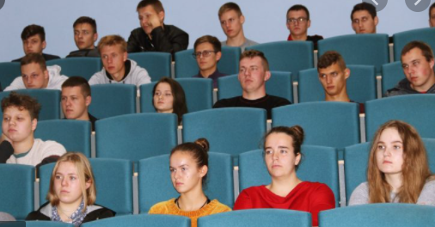
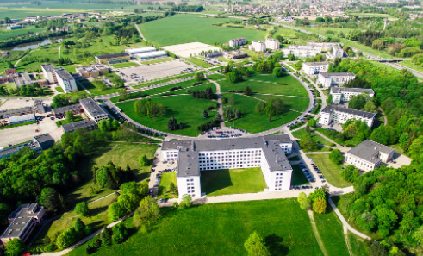
STAGES OF STUDY IN THE PANDEMIC PERIOD
1. From 16 March 2020 to 15 August 2020
2. From 16 August 2021 to 31 October 2020
3. From 1 November 2020 to now
Photo: google.com
Baltic Surveying 2021, Jelgava, 06-05-2021
2

Slide 3

ACTIVITIES
Lectures
Practical assignments
Laboratory works
Practices
Exam and other settlements
Thesis defenses
Photo: google.com
Baltic Surveying 2021, Jelgava, 06-05-2021
2

Slide 4
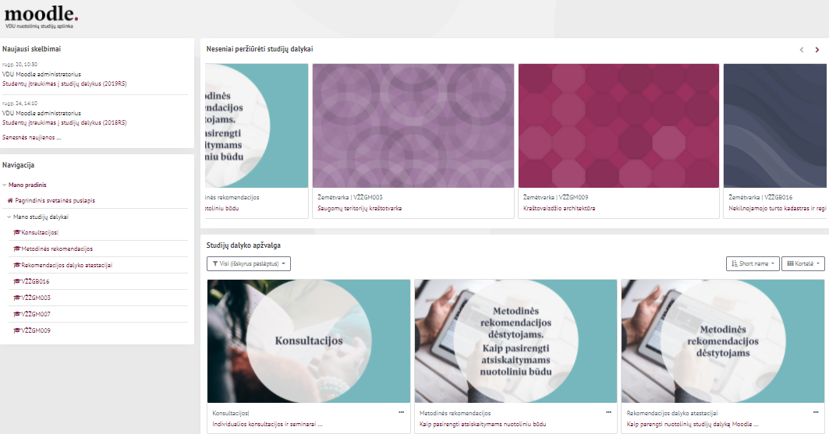
PROGRAMS FOR ON-LINE WORK
Big Blue Button
Adobe Connect
Microsoft Teams
Zoom
System – MOODLE
Photo: google.com
Baltic Surveying 2021, Jelgava, 06-05-2021
2

Slide 5
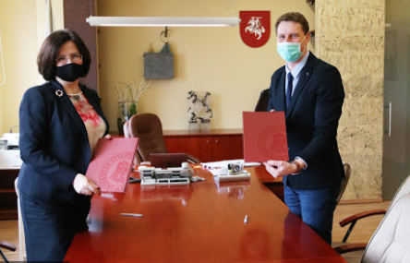
HELP FOR THE UNIVERSITY AND OTHERS
Courses and seminars for teachers and students
Methodical material, Consultations
Library services
Opportunity to participate in conferences, seminars
Protective equipment (masks, disinfectant, etc.)
Possibility to live in dormitories
Possibility to get vaccinated faster
Photo: google.com
Baltic Surveying 2021, Jelgava, 06-05-2021
2

Slide 6
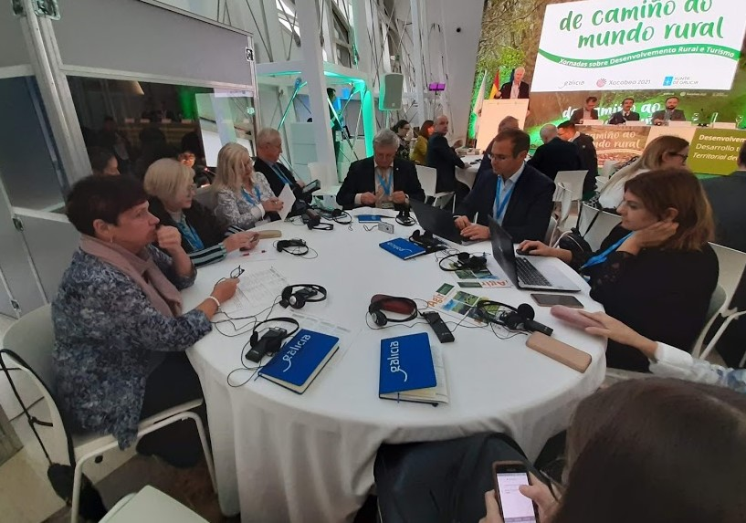
PANDEMIC LESSONS
More classes will be conducted on-line.
More on-line events: conferences, seminars, courses, consultations.
A more responsible approach to health, environment, our planet Earth.
The greatest asset is a direct communication!
Let's maintain communication and organise
new meetings!
Photo: google.com
2
Baltic Surveying 2021, Jelgava, 06-05-2021

Slide 7

Thank you for your attention!
virginija.gurskiene@vdu.lt
jolanta.valciukiene@vdu.lt

